Slide 1
A Forensic Analysis of APT Lateral Movement in Windows Environment
AhnLab
Junghoon Oh

Slide 2
01 02 03 04 05
Introduction
Method of Lateral Movement
Forensic Analysis for Lateral Movement
Case Study
Conclusion

Slide 3
Introduction

Slide 4



Introduction
Lateral Movement ?
Accomplishing Goal of Attack~!!
Initial Breach~!!!
Lateral Movement
Notes:
It is one of APT phases.
Attacker’s movement in internal network after initial breach.
Finding target system is a goal.(ex : DB system)
windows authentication protocol and network share are used.
Hard to distinguish this behavior and normal network behavior

Slide 5
Introduction
Need for Tracing Lateral Movement
Detecting Attack~!!!
Finding Root
Cause~!!!
Tracing Lateral Movement

Slide 6
Method of Lateral Movement

Slide 7
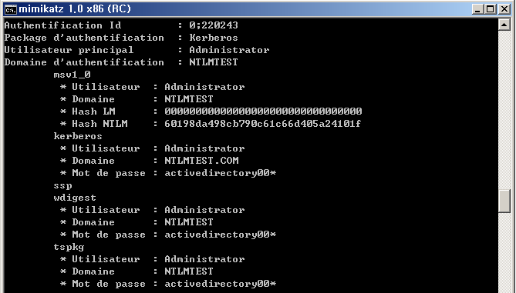

Method of Lateral Movement
Active Directory Environment( in Same Domain )
Administrator System
Stealing
Domain Administrator’s
Decrypted ID/PW or NTLM Credentials From Memory
Domain Administrator’s NTLM Credentials is saved
in Memory(Msv1_0.dll)
Using Domain Administrator Account
Domain Administrator’s encrypted ID/PW is saved
in Memory(Kerberos.dll, Wdigest.dll, tspkg.dll)
RDP
Using Domain Administrator’s NTLM Credentials or ID/PW
Network Share Point
Copy Backdoor
Run Backdoor
Compromised System
Normal System
sc, at, wmic, reg, psexec, winrs
Compromised System

Slide 8
Method of Lateral Movement
Multi-Domain Environment
A Domain
Trust Relationship
B Domain
DC
DC
DC
DC
Notes:
Trust Technologies : http://technet.microsoft.com/en-us/library/cc759554(v=ws.10).aspx

Slide 9
Method of Lateral Movement
Non-Active Directory Environment
All Systems have same Local Administrator Account
(Same ID/PW)
Stealing Local Administrator’s ID/PW(Kerberos.dll, Wdigest.dll, tspkg.dll)
and
NTLM Credentials(Msv1_0.dll)
From Memory
Using Local Administrator’s NTLM Credentials or ID/PW
Network Share Point
Copy Backdoor
Run Backdoor
Compromised System
Normal System
sc, at, wmic, reg, psexec, winrs
Compromised System

Slide 10
Forensic Analysis

Slide 11
Forensic Analysis
Layout of Lateral Movement
Escalation of Privileges
NetworkShare Point
Copy Backdoor
Run Backdoor
Attacker System
Victim System
sc, at, wmic, reg, psexec, winrs
Anti Forensics

Slide 12
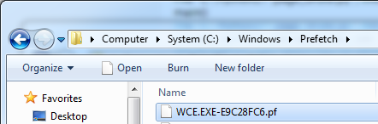

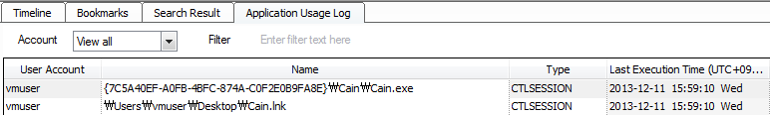
Forensic Analysis
Program Execution
Location : Attacker System
Artifact
Prefetch
Application Compatibility Cache( in Registry )
UserAssist( in Registry )
WCE Execution ~!!
Cain&Abel Execution~!!

Slide 13
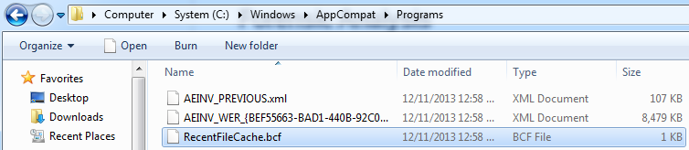
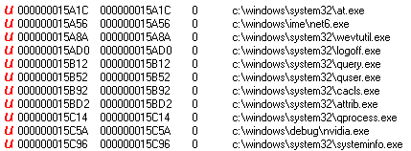
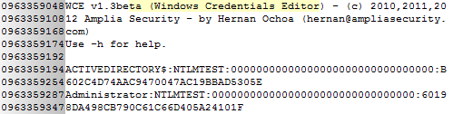
Forensic Analysis
Program Execution
Location : Attacker System
Artifact
RecentFileCache.bcf
Strings in Memory
Launching Job Scheduler for Installing Malware
and
Erasing Event Log
With wevtutil
Launching Malware for Stealing NTLM Credentials
Launching WCE~!!

Slide 14
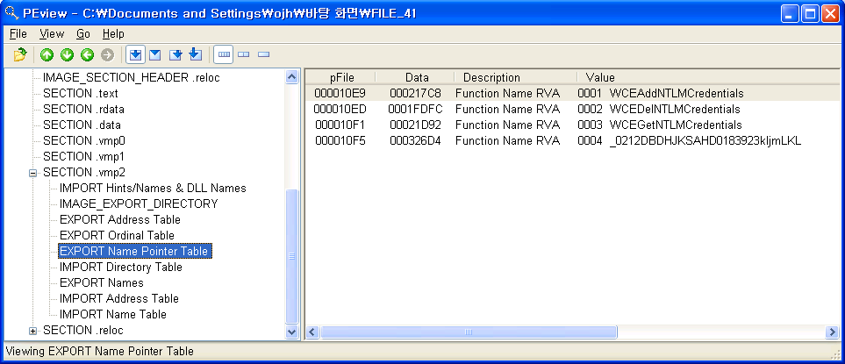
Forensic Analysis
Program Execution
Location : Attacker System
Artifact : wceaux.dll
Dropped DLL from wce.exe
This DLL is injected to LSASS.EXE and used for acquiring/replacing Credentials.
Usually malware saves this dll in it’s resource area and use dll’s export functions.
Malware uses these functions~!!

Slide 15
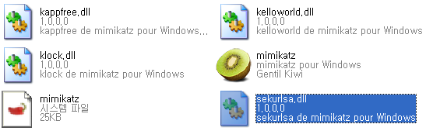
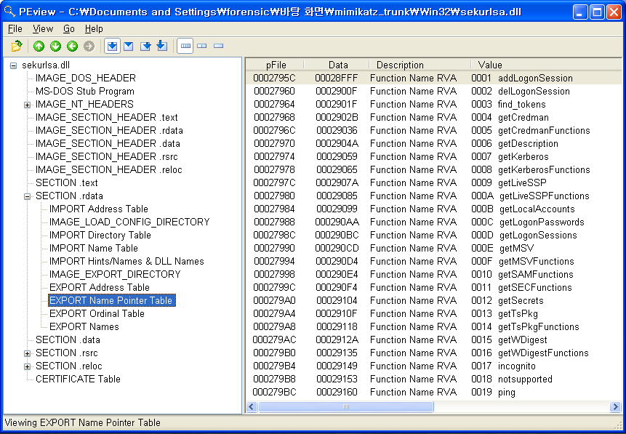
Forensic Analysis
Program Execution
Location : Attacker System
Artifact : sekurlsa.dll
DLL used by mimikatz.exe
This DLL is injected to LSASS.EXE and used for acquiring/replacing Credentials and Password
This DLL is used by malware like wceaux.dll.
Malware uses these functions~!!

Slide 16
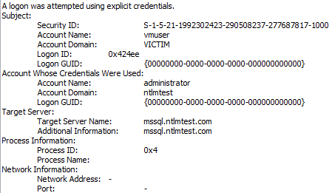
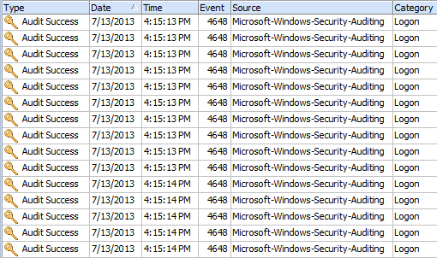
Forensic Analysis
Logon Attempt
Location : Attacker System
Artifact : Security Event Log
The event occurs when attempting to logon to another system ➔ ID : 552(evt) or 4648(evtx)
A logon was attempted using explicit credentials(using ID/PW).
Information
Targeted system name
Process information
Process ID, name
Normal case : lsass.exe(to Remote), winlogon.exe(to Local), taskhost.exe(to Local), consent.exe(to Local)
Suspicious case : 0x4(system), cscript.exe, svchost.exe(to Remote)
Characteristics of this behavior
Attempting 10 times logon per second through automation
There is no information whether logon succeeds or not.
Attack Automation~!!

Slide 17
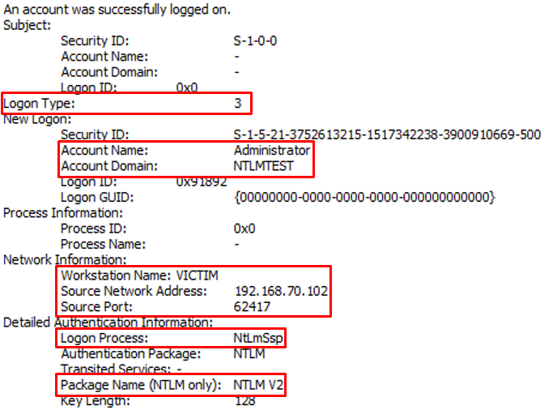
Forensic Analysis
NTLM Authentication
Location : Victim System
Artifact : Security Event Log
Network Logon through NTLM authentication ➔ ID : 540(evt) or 4624(evtx)
Condition
Logon Type : 3
Logon Process : NtLmSsp
Package Name : NTLM V2 ➔ In Case of XP SP3, NTLM
Information
New Logon : Account Name, Domain
Network Information : Workstation Name, IP, Port
Using NTLM Authentication~!!
Notes:
When ?
Connecting Network Share
IPC$ Share : net use \\192.168.70.101
Network Drive : net use z: \\192.168.70.101\C$
After “Pass the Hash” Attack, this event occurs in case of below behaviors(No $IPC share session)
Direct copying through network share : copy backdoor.exe \\192.168.70.101\C$
Remote service registration/execution with SC command
Remote job schedule registration with at command
Remote execution with wmic command
Remote registry registration with reg
Remote execution with psexec
Remote execution with winrs (through IP)

Slide 18
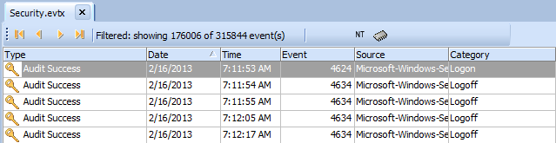
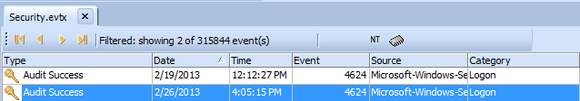
Forensic Analysis
NTLM Authentication
Real Case : Finding Lateral Movement
Online Game Company
The Security Event Log of Compromised DC(Domain Controller) Server ➔ 3158244 records
The filtering result with “Logon Type : 3” keyword(Network Logon) ➔ 176006 records
The filtering result with “NTLM V2” keyword ➔ 2 records
Performing cross analysis with other artifacts ➔ second record includes attack event~!!

Slide 19
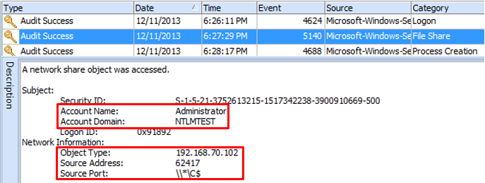
Forensic Analysis
Copying Backdoor
Location : Victim System
Artifact : Security Event Log
File share ➔ ID : 5140 (Not default)
Information
New Logon : Account Name, Domain
Network Information : System IP, Network Share Point
When?
Direct copying through network share : copy backdoor.exe \\192.168.70.101\C$

Slide 20
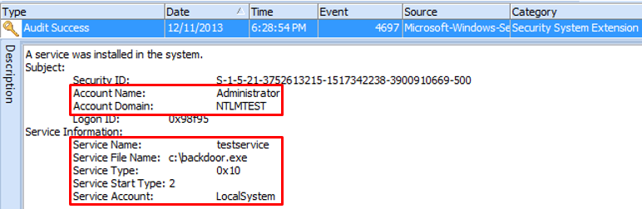
Forensic Analysis
Remote service registration/execution
Location : Victim System
Artifact : Security Event Log
Service Installation ➔ ID : 4697(Not Default)
Information
Account Name, Domain
Service Name, Service File Name

Slide 21
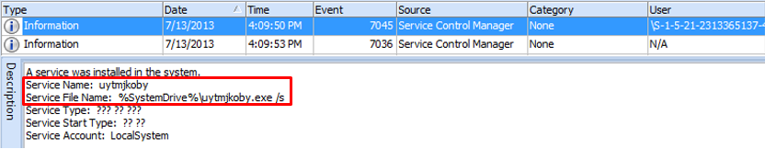
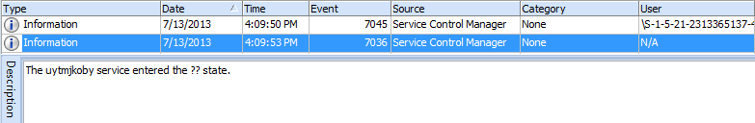
Forensic Analysis
Remote service registration/execution
Location : Victim System
Artifact : SYSTEM Event Log
Service Installation ➔ ID : 7045
Information
Service Name
Service File Name
Changing Service State ➔ ID : 7036
Information
Whether backdoor is executed or not

Slide 22
Forensic Analysis
Remote job schedule registration, execution and deletion
Location : Victim System
Artifact : Task Scheduler Event Log(since win7)
Registering Job schedule ➔ ID : 106
Account Name used to registration
Job Name : Usually “At#” form
Starting Job schedule ➔ ID : 200
The path of file executed for job
Deleting Job schedule ➔ ID : 141
Account Name used to registration

Slide 23
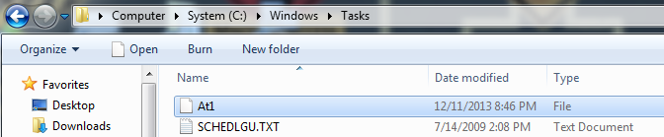
Forensic Analysis
Remote job schedule registration, execution and deletion
Location : Victim System
Artifact : Tasks Folder
Creating “At#.job” file under “Tasks” folder
Changing time information of “Tasks” folder
This occurs by creating “At#.job” file.
Last Written
Last Accessed
MFT Entry Mdofied

Slide 24
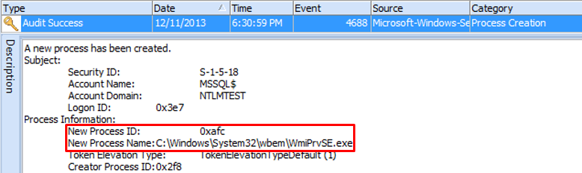
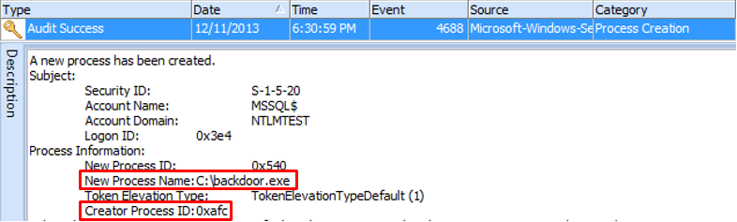
Forensic Analysis
Remote execution with wmic
Location : Victim System
Artifact : Security Event Log
Creating Process ➔ ID : 4688(Not Default)
After creating “WmiPrvSE.exe” process, “WmiPrvSE.exe” creates backdoor process.

Slide 25
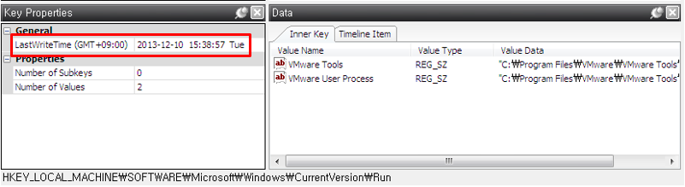
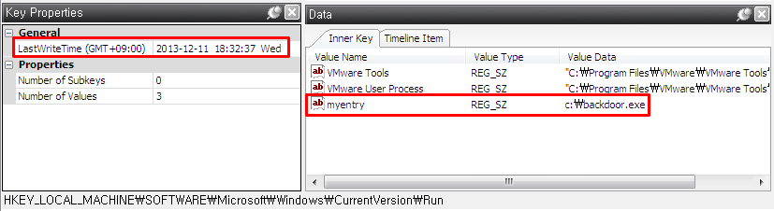
Forensic Analysis
Remote registry registration
Location : Victim System
Artifact : Registry
Changing “Last Written Time” of relevant key

Slide 26
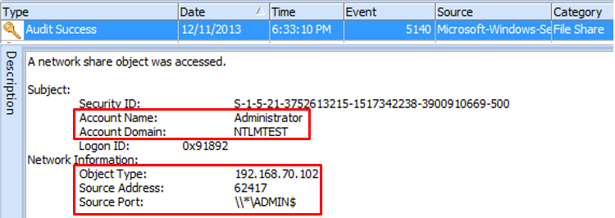
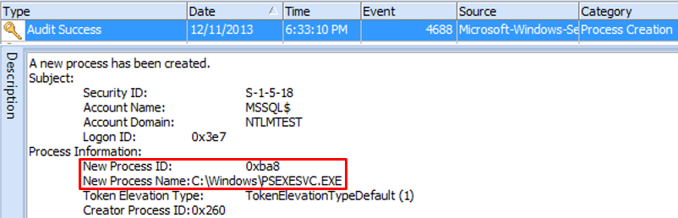
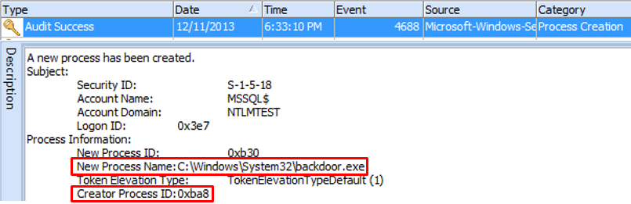
Forensic Analysis
Remote execution with psexec
Location : Victim System
Artifact : Security Event Log
File Share ➔ ID : 5140(Not Default)
Copying backdoor to “SYSTEM32” folder ➔ ADMIN$ share
Creating Process ➔ ID : 4688(Not Default)
After creating “PSEXESVC.EXE” process, “PSEXESVC.EXE” creates backdoor process.

Slide 27
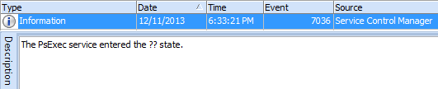
Forensic Analysis
Remote execution with psexec
Location : Victim System
Artifact : SYSTEM Event Log
Changing Service State ➔ ID : 7036
Starting PsExec Service

Slide 28

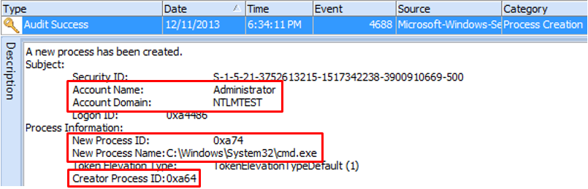
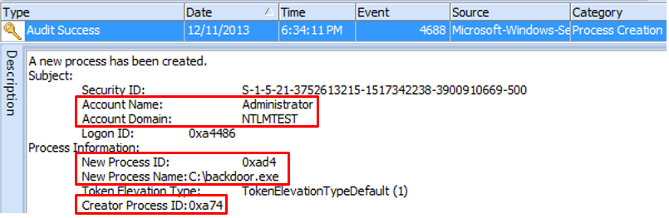
Forensic Analysis
Remote execution with winrs
Location : Victim System
Artifact : Security Event Log
Creating Process ➔ ID : 4688(Not Default)
After Creating “winrshost.exe” process, “winrshost.exe” creates backdoor process through cmd.exe process
The subject of executing backdoor is User Account unlike psexec.

Slide 29

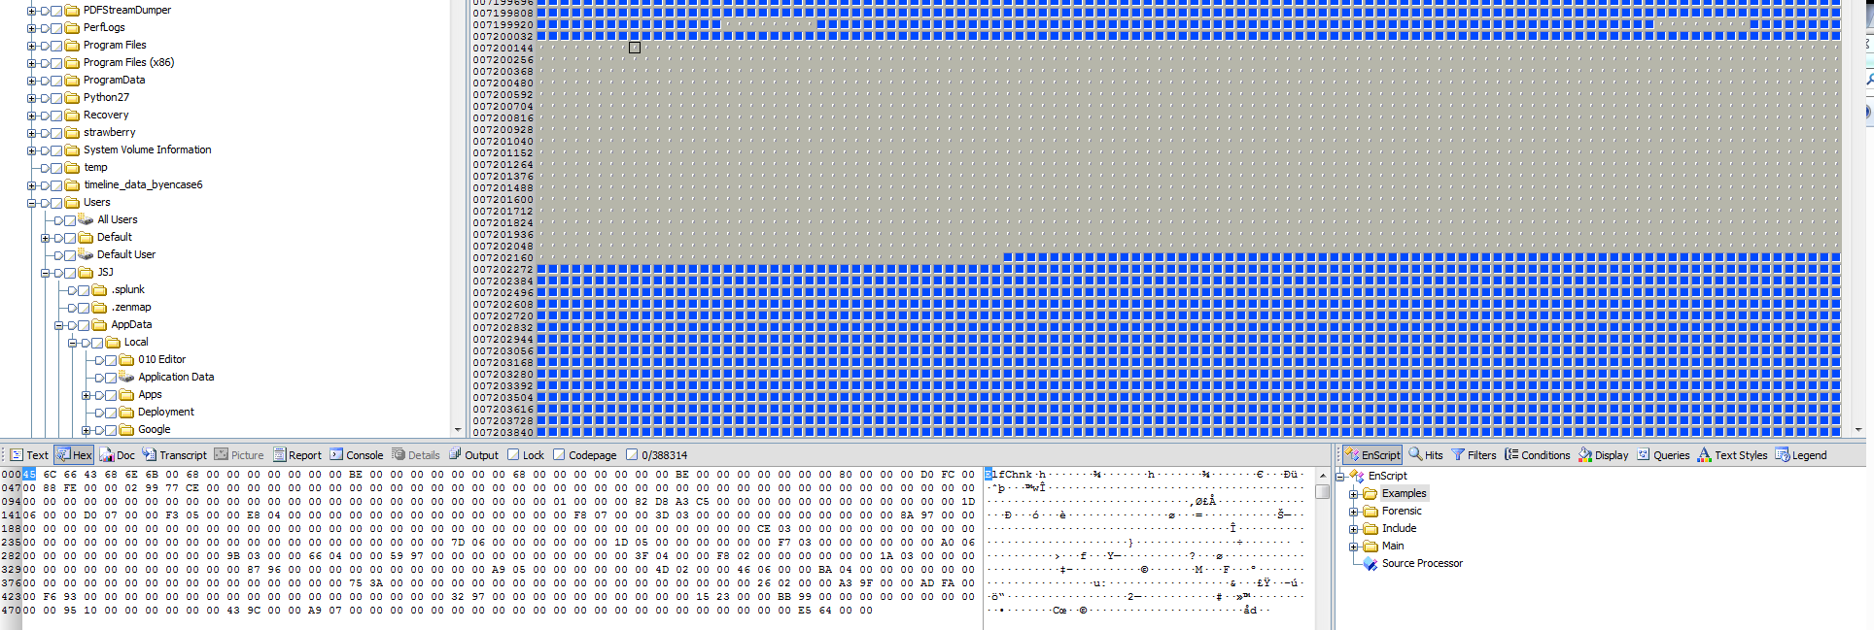
Forensic Analysis
Countermeasure for Anti Forensics
Anti Forensic behavior
After installing backdoor, attacker deletes of “Event Log”, job file and backdoor installation file
Countermeasure
Recovering Deleted Event Log
There are event log records in unallocated space, after deleting with “wevtutil cl”➔ Record Carving~!!

Slide 30


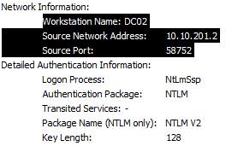
Forensic Analysis
Countermeasure for Anti Forensics
Recovering Deleted Event Records
Back-Tracking~!!
Pass the Hash
Network Share
Unallocated Space
Record
Header
Record
Record
Record
Record
Record
Record
Footer
Record

Slide 31
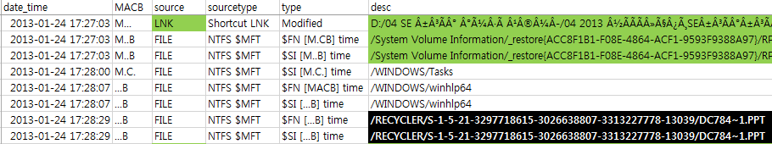
Forensic Analysis
Countermeasure for Anti Forensics
Countermeasure(continue…)
Deleting job file
Job file is in $MFT with form of resident file due to the file size( < 870 byte ) ➔ Searching within $MFT
“MFT Modified Time” of “Tasks” folder is used to find attack time

Slide 32
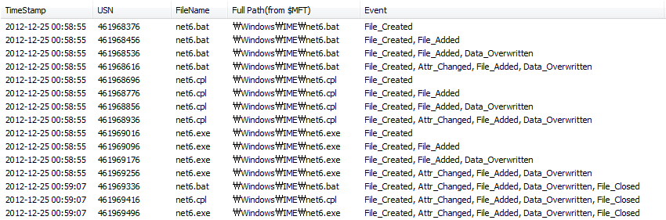
Forensic Analysis
Countermeasure for Anti Forensics
Countermeasure(continue…)
Deleting malware file
Analyzing file system log($LogFile, $UsnJrnl)
NTFS Log Tracker : https://sites.google.com/site/forensicnote/ntfs-log-tracker

Slide 33
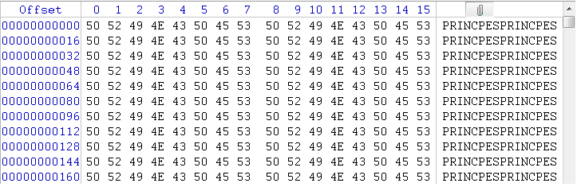
Forensic Analysis
Countermeasure for Anti Forensics
Disk Destruction( ex : 3.20 / 6.25 Cyber Attack in South Korea )
Disk
Overwrited Data
MBR
File System
Destruction
VBR
Overwrited Data
VBR
Overwrited Data

Slide 34
Forensic Analysis
Countermeasure for Anti Forensics
Countermeasure for Disk Destruction
Recovering VBR by Backup VBT located in end of volume
Creating New MBR
Disk
MBR
Overwrited Data
New MBR
Overwrited Data
VBR
VBR
Backup VBR
Backup VBR
Overwrited Data
VBR
VBR
Backup VBR
Backup VBR

Slide 35
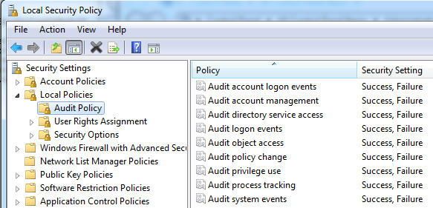

Forensic Analysis
Forensic Readiness
Event Log
Remote backup Server
Real-time Backup
The backup server should be excluded in domain.
Audit policy : Turn on all audits
Changing size of event log

Slide 36
Forensic Analysis
Forensic Readiness
$LogFile, $UsnJrnl
Changing size of log file
$LogFile : chkdsk /L:<size>(KB)
Usually 64M ➔ log data is saved for about 3 hours
One percent of volume size is recommended.
$UsnJrnl : fsutil usn createjournal m=<size>(byte) a=<size>(byte) <volume>
Usually 32M ➔ log data is saved for about 1~2 days
One percent of volume size is recommended.

Slide 37
Forensic Analysis
Summary
Attacker System
Behavior | Artifact | Detail
Escalation of Privileges | Prefetch | Program Execution
 | Application Compatibility Cache | Program Execution
 | RecentFileCache.bcf | Program Execution
 | wceaux.dll | DLL of WCE
 | sekurlsa.dll | DLL of Mimitakz
 | Memory | String search
Attempting Logon | Security Event Log | Attempting Logon to another system with explicit credentials ID : 552(evt) or 4648(evtx)

Slide 38
Forensic Analysis
Summary
Victim System
Behavior | Artifact | Detail
NTLM Authentication | Security Event Log | Network Logon( ID : 540 or 4624 ) Logon Type : 3 Logon Process : NtLmSsp Package Name : NTLM V2 or NTLM
 | Network Traffic | Protocol : SMB2 Characteristics SessionSetup : NTLMSSP_NEGOTIATE SessionSetup : NTLMSSP_AUTH, Domain, Username TreeConnect : \\<IP or Host Name>\IPC$
Copying Backdoor | Security Event Log | File Share( ID : 5140 )
 | Network Traffic | Protocol : SMB2 Characteristics TreeConnect : \\<IP or Host Name>\<Share Point : C$, D$ … > Create Write
Remote service registration/execution | Security Event Log | Installing Service( ID : 4697 )
 | System Event Log | Installing Service( ID : 7045 ) Changing Service State( ID : 7036 )
 | Network Traffic | Protocol : SVCCTL Characteristics OpenSCManager CreateService or OpenService, StartService CloseSeviceHandle

Slide 39
Forensic Analysis
Summary
Victim System (continue…)
Behavior | Artifact | Detail
Remote job schedule registration and execution, deletion | Task Scheduler Event Log | Registering Job( ID : 106 ) Starting Job( ID : 200 ) Deleting Job( ID : 141 )
 | Tasks folder | Changing time information of “Tasks” folder by Creating “At#.job” file
 | Network Traffic | Protocol : ATSVC Characteristics : JobAdd
Remote execution with wmic | Security Event Log | Creating Process( ID : 4688 ) ➔ WmiPrvSE.exe
Remote registry registration | Software Registry | HKLM\SOFTWARE\Microsoft\Windows\CurrentVersion\Run
 | Network Traffic | Protocol : WINREG Characteristics OPENHKLM CreateKey QueryValue SetValue CloseKey
Remote execution with psexec | Security Event Log | File Share( ID : 5140 ) ➔ $ADMIN share Creating Process( ID : 4688 ) ➔ PSEXESVC.EXE
 | System Event Log | Changing Service State( ID : 7036) ➔ starting PsExec service
 | Network Traffic | Protocol : SMB2 Characteristics TreeConnect : \\<IP or Host Name>\ADMIN$ Create : PSEXESVC.EXE Create : svcctl Create : 실행 파일

Slide 40
Forensic Analysis
Summary
Victim System (continue…)
Countermeasure for Anti Forensics
Forensic Readiness
Behavior | Artifact | Detail
Remote execution with winrs | Security Event Log | Creating Process( ID : 4688 ) ➔ winrshost.exe
 | Network Traffic | Protocol : HTTP Characteristics NTLMSSSP_NEGOTIATE : /wsman NTLMSSP_AUTH : Domain, Username
Behavior | Response | Detail
Deleting Event Log | Recovering Event Log | Record Carving
Deleting Job file | Keyword Search | Searching within $MFT
 | Confirming MFT Modified Time of Tasks folder | Guessing creation and deletion time of job file
Deleting file | Analyzing File System Log($LogFile, $UsnJrnl) | Using “NTFS Log Tracker”
Target | Response | Detail
Event Log | Remote Backup Server | Real-time backup Backup server not included in domain
 | Setting Audit Policy | Turn On all audits
 | Changing size of event log file | wevtutil sl
$LogFile, $UsnJrnl | Changing size of log file | $LogFile ➔ chkdsk $UsnJrnl ➔ fsutil

Slide 41
Case Study

Slide 42

Case Study
Case Study 1 : Defense Contractor in South Korea
“This system is compromised.”
From. Mandiant
: Back Tracking
Office Network
(Not AD Environment)
All systems have same local administrator ID/PW…
Military Research Institute’s Web Server
➔ Watering Hole Attack~!!
Drive by Download

Slide 43

Case Study
Case Study 2 : Online Game Company in South Korea
: Back Tracking
Fabricating
Game Money~!!
Server Farm
(AD Environment)
Office Network
(AD Environment)
Analyzing
FTP Log
Can’t find any traces
Before Formatting
DB
Using Domain administrator’s Credentials…
File Server
DB
Downloading
Nvidia Driver Installation Program (Malicious)
Recovering
Deleted
Event Records
Gateway Server Connected to Office Network
Gate Way
VPN
Using Domain administrator’s Credentials…
Keylogging

Slide 44
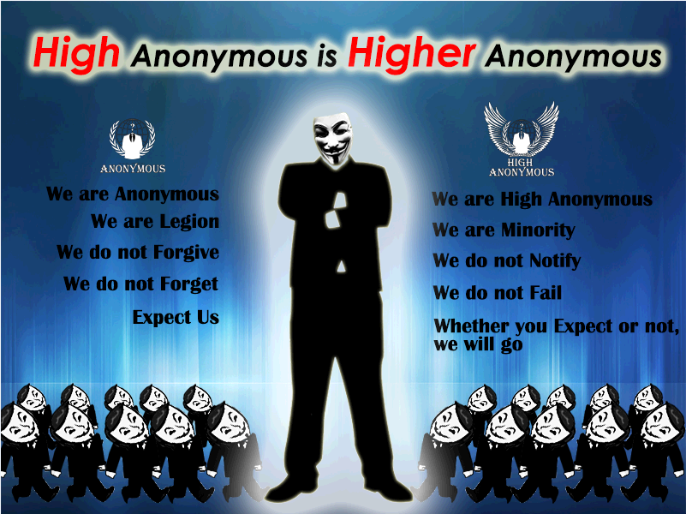
Case Study
Case Study 3 : 6.25 Cyber Attack in South Korea
: Back Tracking
Cable TV Company
C&C
Server~!!
All systems’s password and wall paper are changed.
After reset, system become unbootable…
?
B branch’s Server Farm
All systems have same local administrator ID/PW…
…
Malware Functions
Changing password
Lateral Movement via Network share
Disk Destruction
C&C Connection
C&C Connection
Private Line
Private Line
A branch’s Server Farm
C&C Connection
?
C branch’s Server Farm
…
Private Line
…
Recovering
Destroyed
File System

Slide 45
Conclusion

Slide 46
Conclusion
APT Lateral Movement
Moving laterally to find targeted server in internal network
Using windows authentication protocol ➔ Difficulty of classification
Necessity of Forensic Analysis ➔ Removing Root cause through tracebacking.
Forensic Analysis
Malware Execution
Tracing NTLM Authentication
Countermeasure for Anti Forensics
Forensic Readiness

Slide 48
Reference
Mimikatz : http://blog.gentilkiwi.com/mimikatz
WCE : http://www.ampliasecurity.com/research/wcefaq.html
Authenticated Remote Code Execution Methods in Windows : http://www.scriptjunkie.us/2013/02/authenticated-remote-code-execution-methods-in-windows/
Mitigating Pass-the-Hash (PtH) Attacks and Other Credential Theft Techniques : http://www.microsoft.com/en-us/download/details.aspx?id=36036
Trust Technologies : http://technet.microsoft.com/en-us/library/cc759554(v=ws.10).aspx

